Slide 1

Anomalous Diffusion of mRNA in the Cytoplasm of HeLa Cells
Ryan Roessler | Master of Science | Fall 2023

Slide 2
Talk Outline
Motivation
Diffusion & Mean Square Displacement (MSD)
Microscopy & Single Particle Tracking (SPT)
Results and Analysis
Conclusion / Future Aims

Slide 3
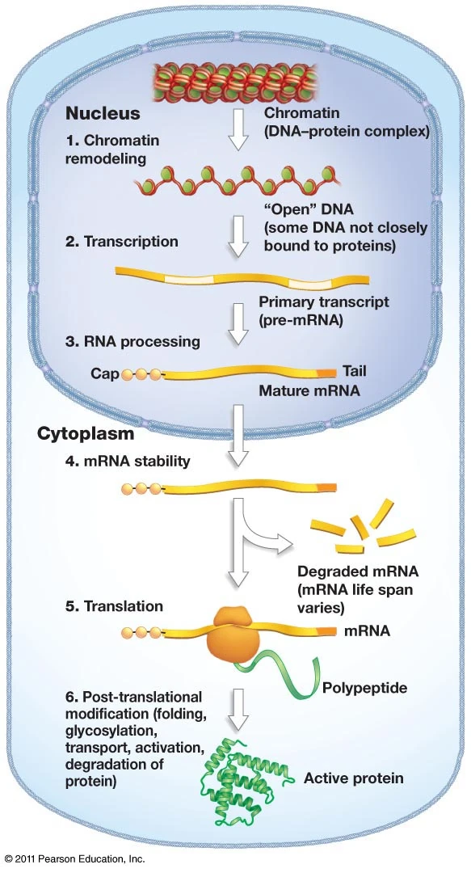
Motivation
DNA → mRNA → Protein Synthesis
mRNA must diffuse out of the nucleus, then find ribosomes
Ribosomes may also be moving
miRNA regulation of gene expression
miRNA must locate mRNA and gene seq.
Intracellular structures can dictate diffusive behavior
We study HeLa cells because they are human cells
Russell, Peter J. IGenetics: A Molecular Approach (2010).
Notes:
Gasses crossing capillary beds from lungs to bloodstream
Water and nutrients in and out of cells
miRNA are small non-coding guide molecules

Slide 4
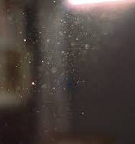
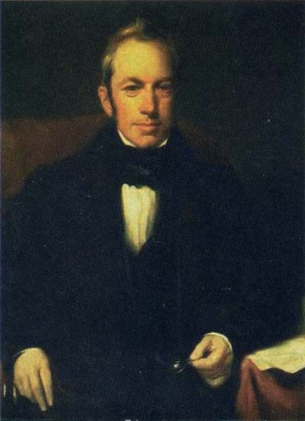
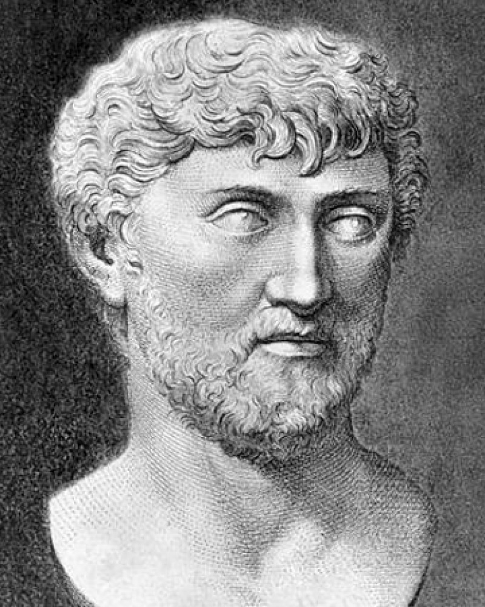
Diffusion
“Thus motion ascends from the primevals on, and stage by stage emerges to our sense, until those objects also move which we can mark in sunbeams, though it not appears what blows do urge them.” –Titus Lucretius Carus (60 BCE)
Robert Brown (1827) observed when a pollen granule (∼5 μm) is immersed in water, the microscopic movement of the water molecules (∼3 Å) gives rise to the random motion of the pollen.
Titus Lucretius and William Ellery Leonard. (2008)
Helmut Mehrer and Nicolaas A Stolwijk. (2009)
Notes:
Gasses crossing capillary beds from lungs to bloodstream
Water and nutrients in and out of cells
miRNA are small non-coding guide molecules

Slide 5
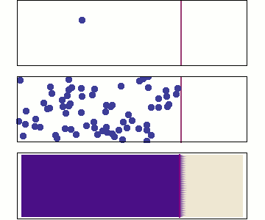
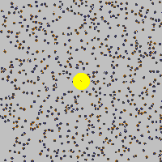
Diffusion
Brownian motion:
Driven by thermal fluctuations
Independent, uncorrelated displacements
No memory
Ergodic
Macroscopic Microscopic
jemdoc + MathJax, MIT.edu, (2017).

Slide 6
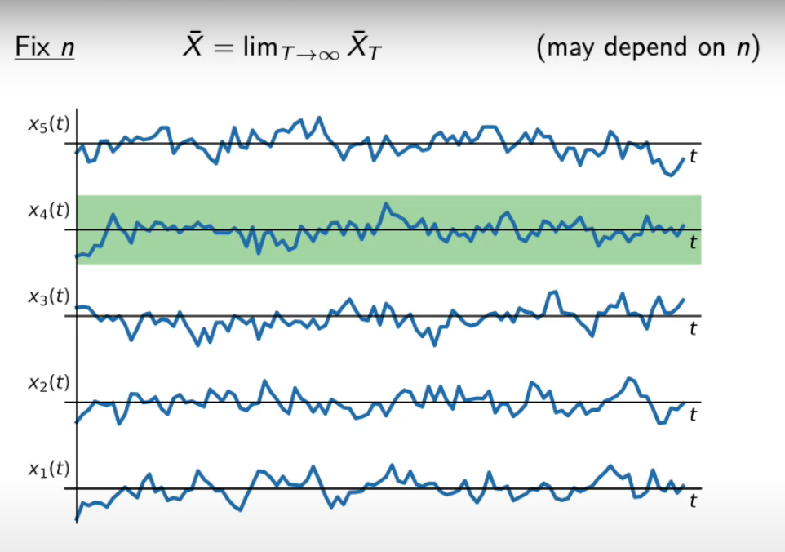
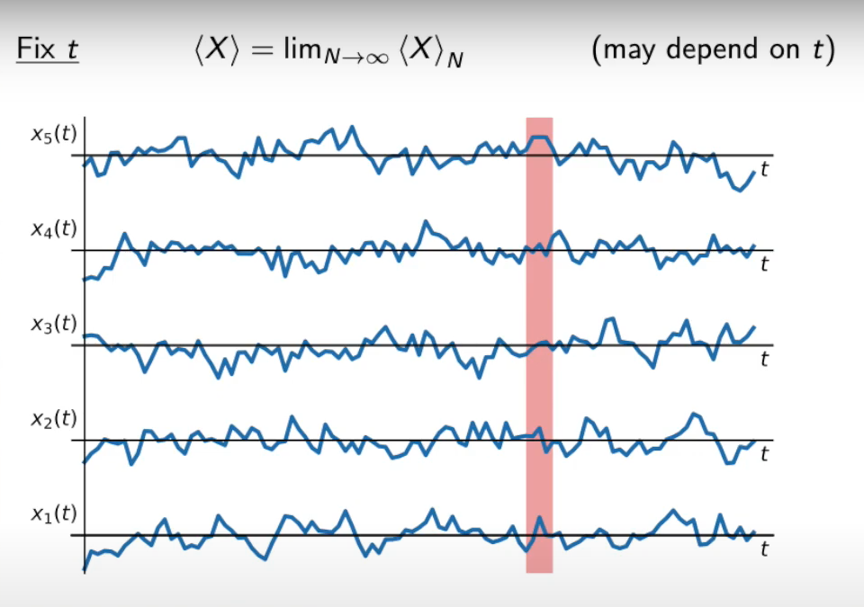
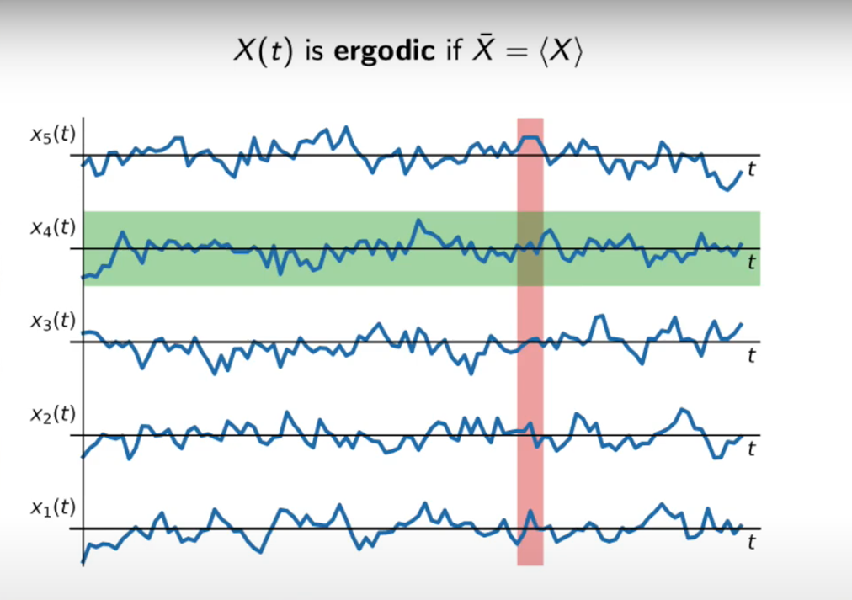
Ergodicity
Time-averaged (TA) Ensemble-averaged (EA) Ergodic when TA = EA
for T ∞ and N ∞
Alex Adamou, Ergodicity TV, (2021).

Slide 7
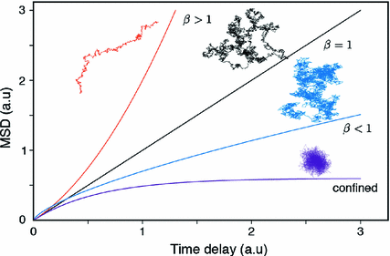
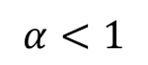
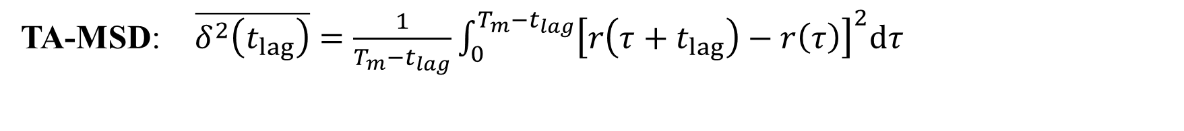
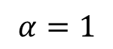
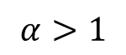
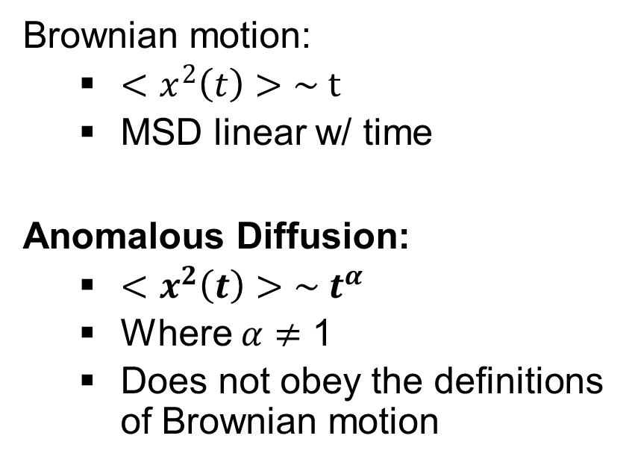
Mean Square Displacement (MSD)
TA-MSD: $\overline{δ^{2}\left(t_{lag}\right)}=\frac{1}{T_{m}−t_{lag}}\int_{0}^{T_{m}−t_{lag}}{{\left[r\left(τ+t_{lag}\right)−r\left(τ\right)\right]}^{2}dτ}$
$$α>1$$
$$α=1$$
Brownian motion:
$<x^{2}\left(t\right)>\sim t$
MSD linear w/ time
Anomalous Diffusion:
$<x^{2}\left(t\right)>\sim t^{α}$
Where $α$ $≠$ 1
Does not obey the definitions of Brownian motion
MSD
$$α<1$$
lagt (s)
Adapted from Ortega Arroyo, J. Springer Theses, (2018).

Slide 8
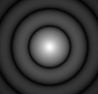
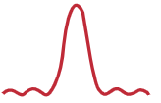
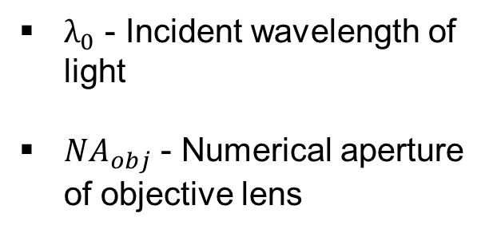
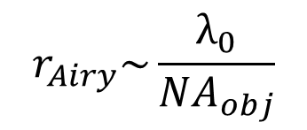
Microscopy: Diffraction Limit
$λ_{0}$ - Incident wavelength of light
${NA}_{obj}$ - Numerical aperture of objective lens
$$r_{Airy}\sim \frac{λ_{0}}{{NA}_{obj}}$$
Greg Hollows, Nicholas James, Edmund Optics

Slide 9
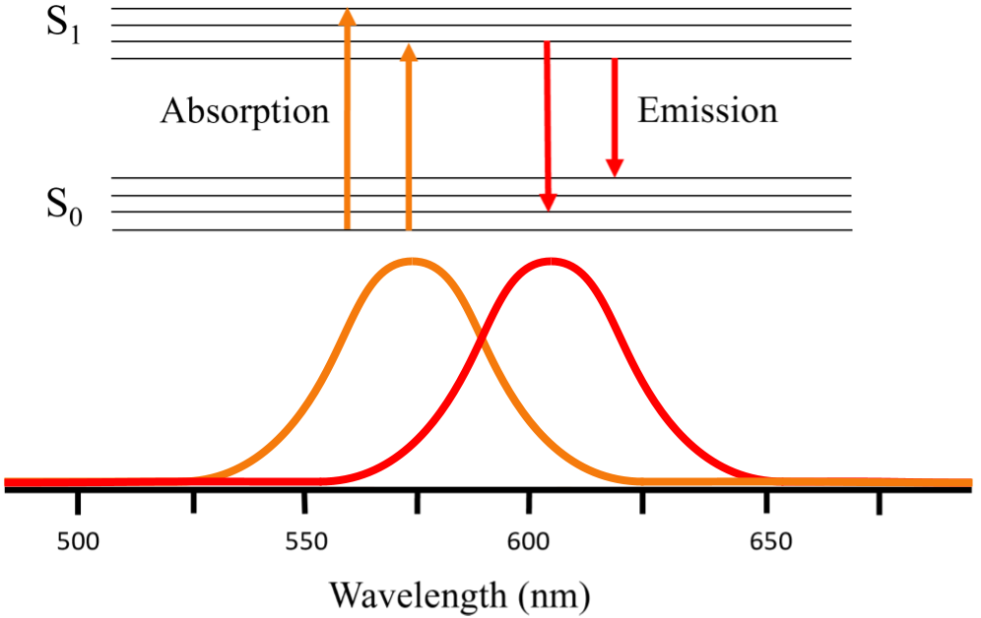
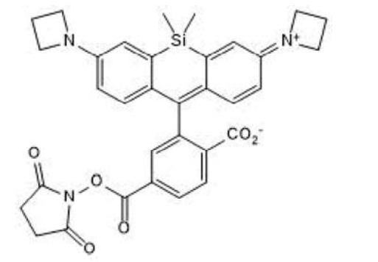
Fluorescence Microscopy
Janelia Fluor (JF) 646
Adapted from Lichtman, Jeff W. and Conchello, Jose Angel. (2005)

Slide 10
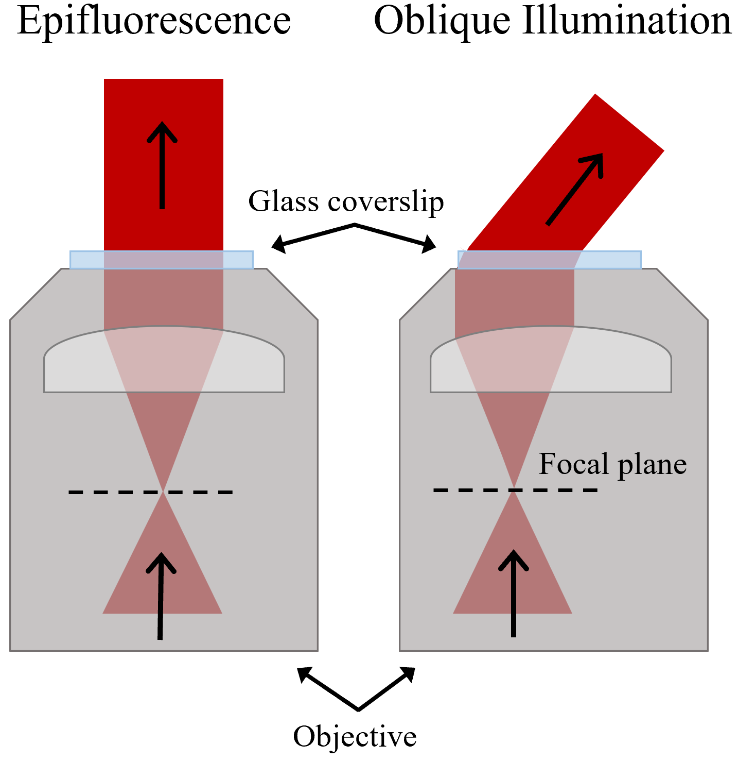
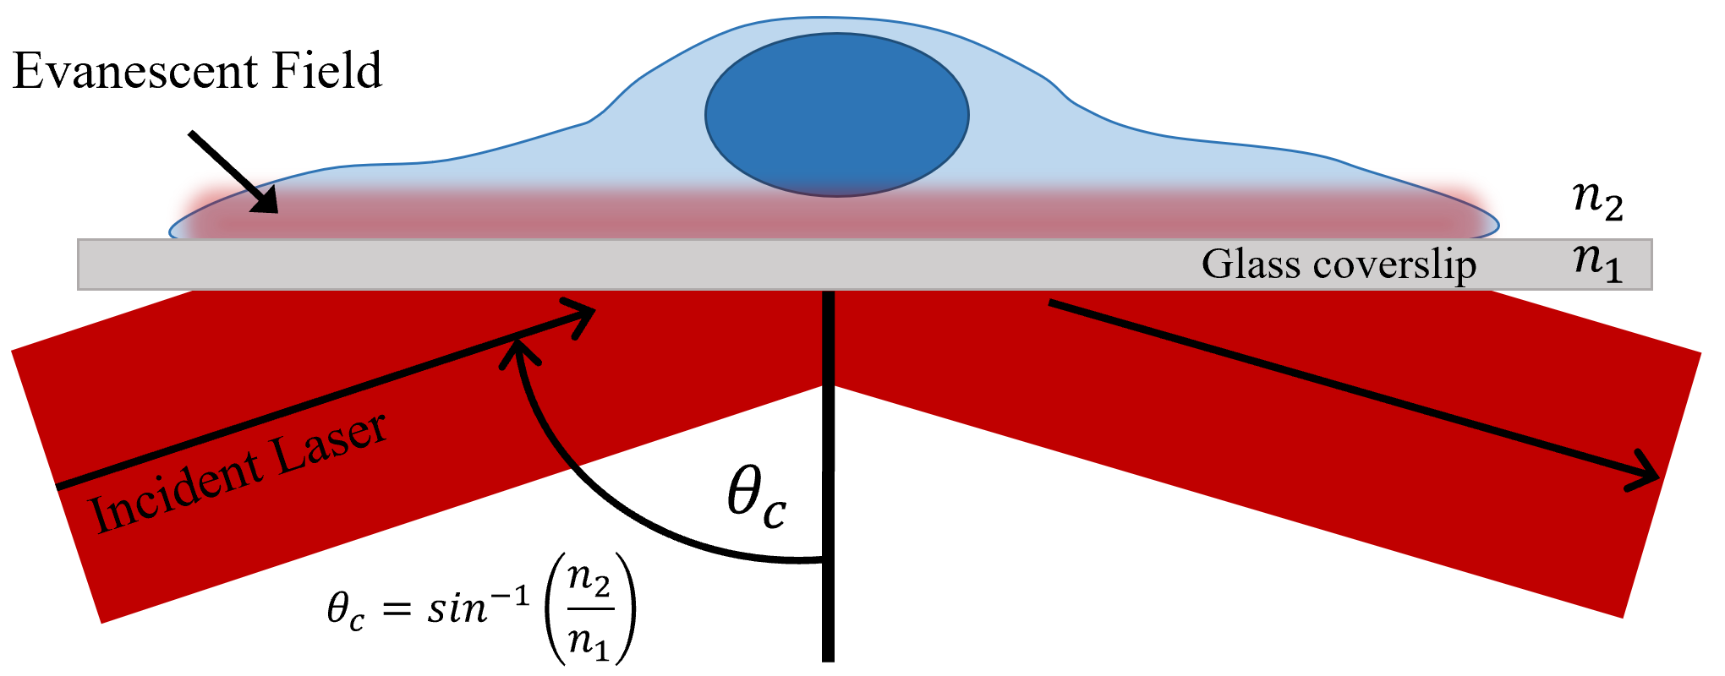
Microscopy: TIRF
TIRF Variations
Total Internal Reflection (TIRF)
Adapted from Adrien Mau et al. bioRxiv. (2020).

Slide 11
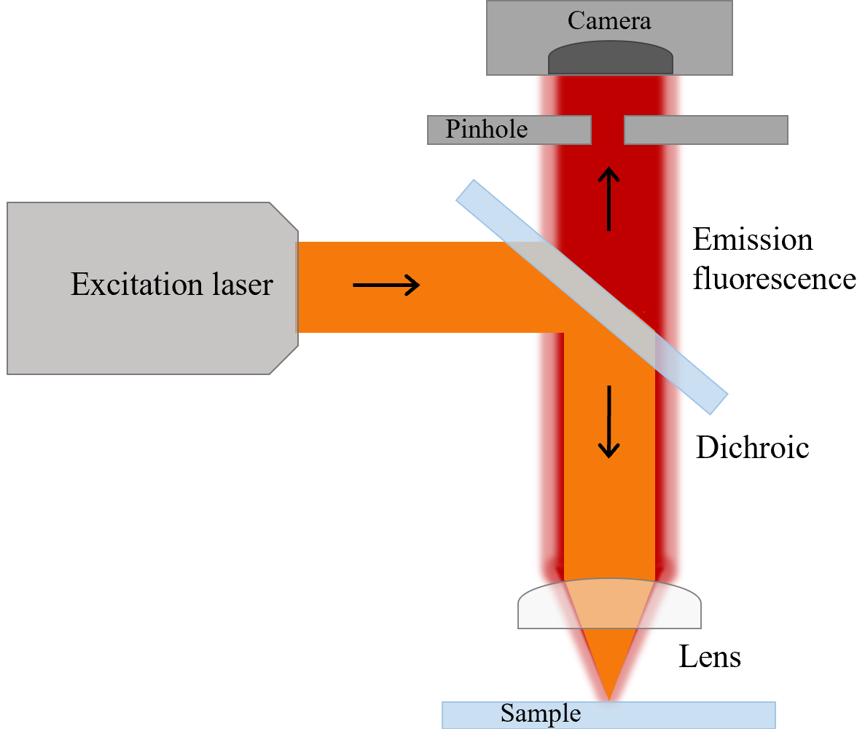
Microscopy: Confocal
Confocal Fluorescence Microscopy
Sample
Focal planes
Adapted from Adaobi Nwaneshiudu et al. Journal of Investigative Dermatology (2012)

Slide 12
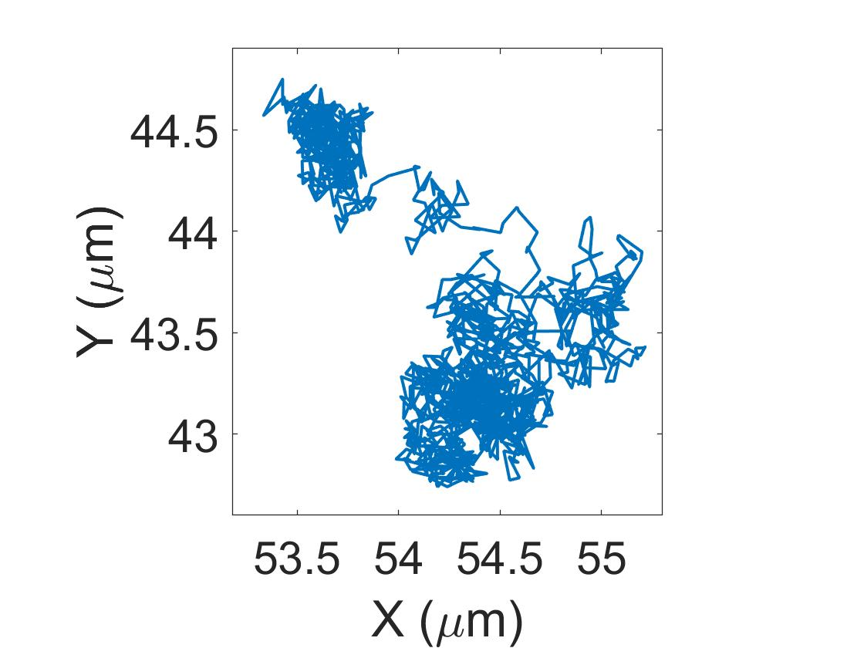
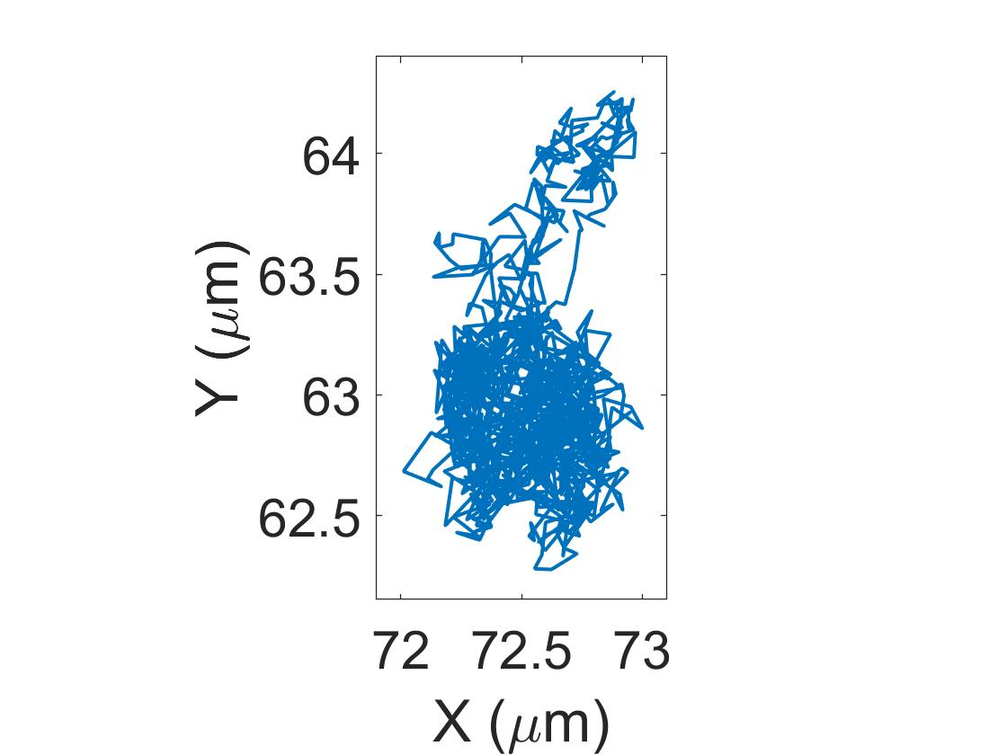
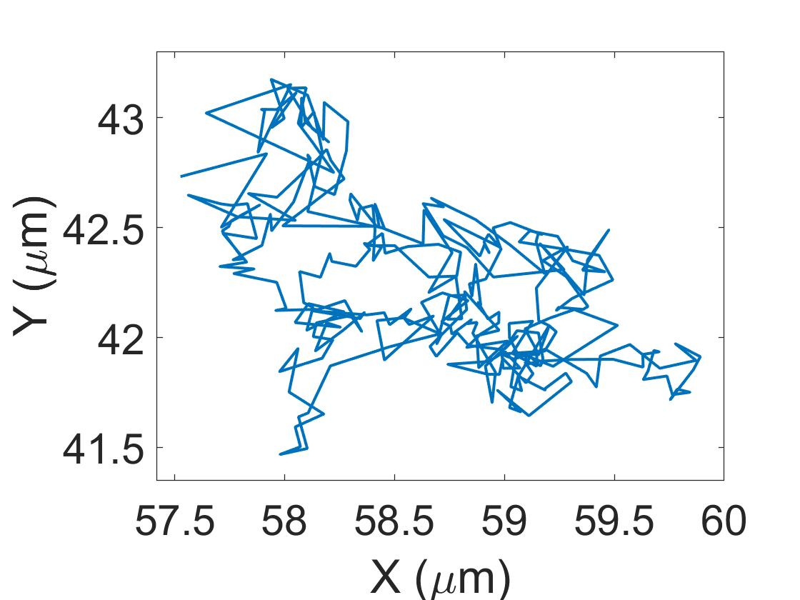
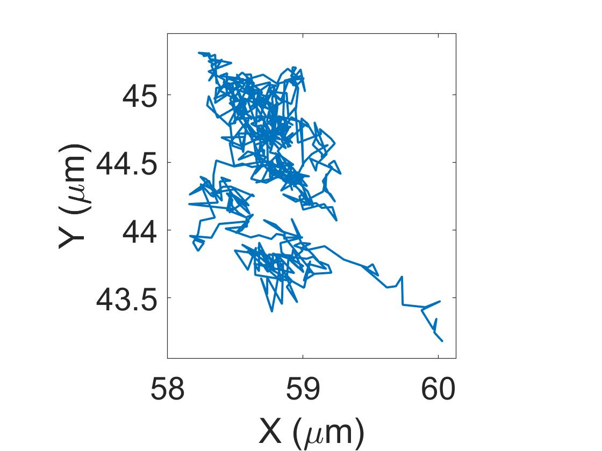
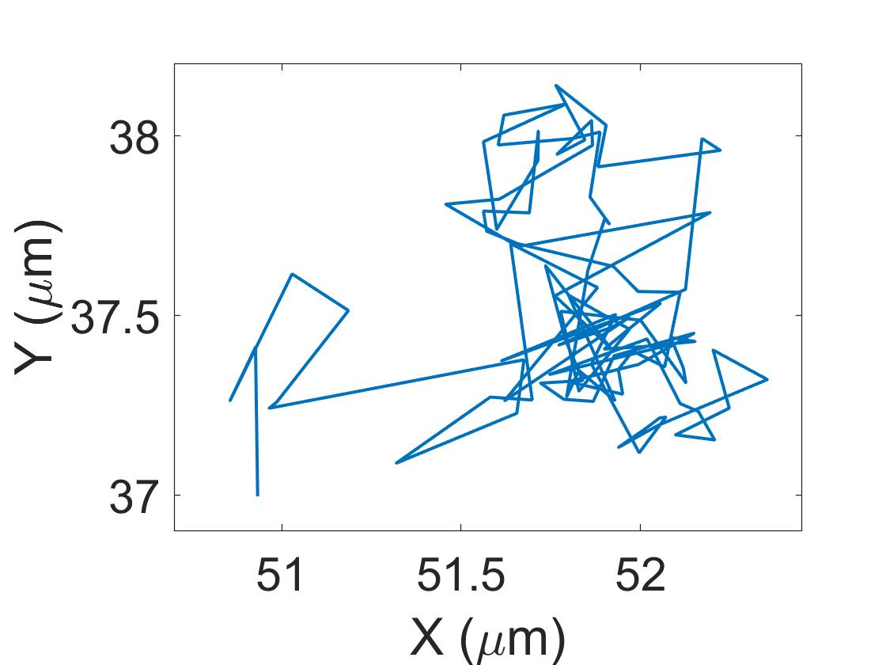
Single-particle Tracking of mRNA Molecules
1 µm

Slide 13
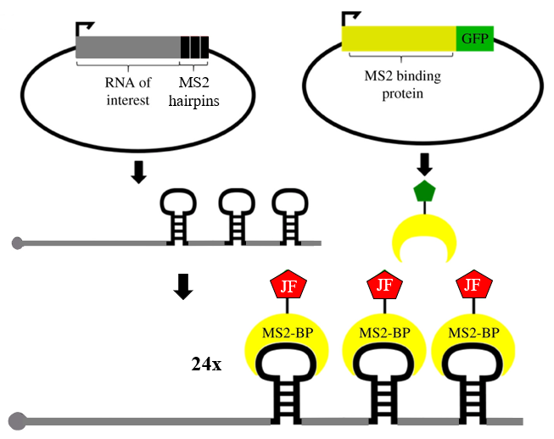
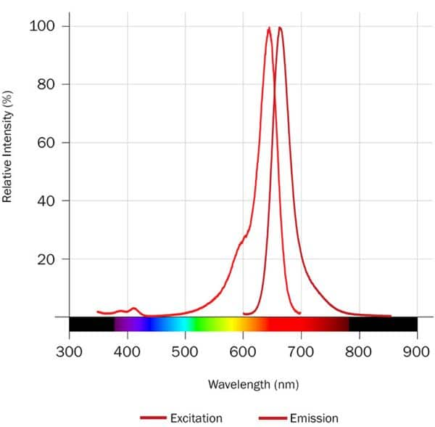
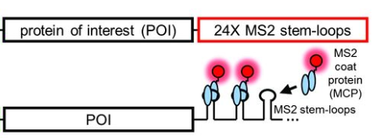
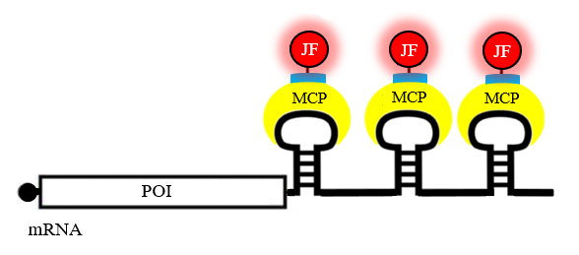

SPT: Labeling
Janelia Fluor (JF) 646 Spectrum
1.)
2.)
Halo Tag
24x
MYH9 seq.
MS2 stem loops
MS2 coat protein (MCP)
Stable plasmid transfection
Relative Intensity (%)
CRISPR
Excitation
Emission
mRNA
JF
JF
JF
JF
MCP
MCP
MCP
mRNA
Wavelength (nm)
POI
JF
3.)
JF – Halo ligand
mRNA
Constructed by O’Neil Wiggan & Tim Stasevich
Morisaki T, et al.TJ. Science. (2016)

Slide 14
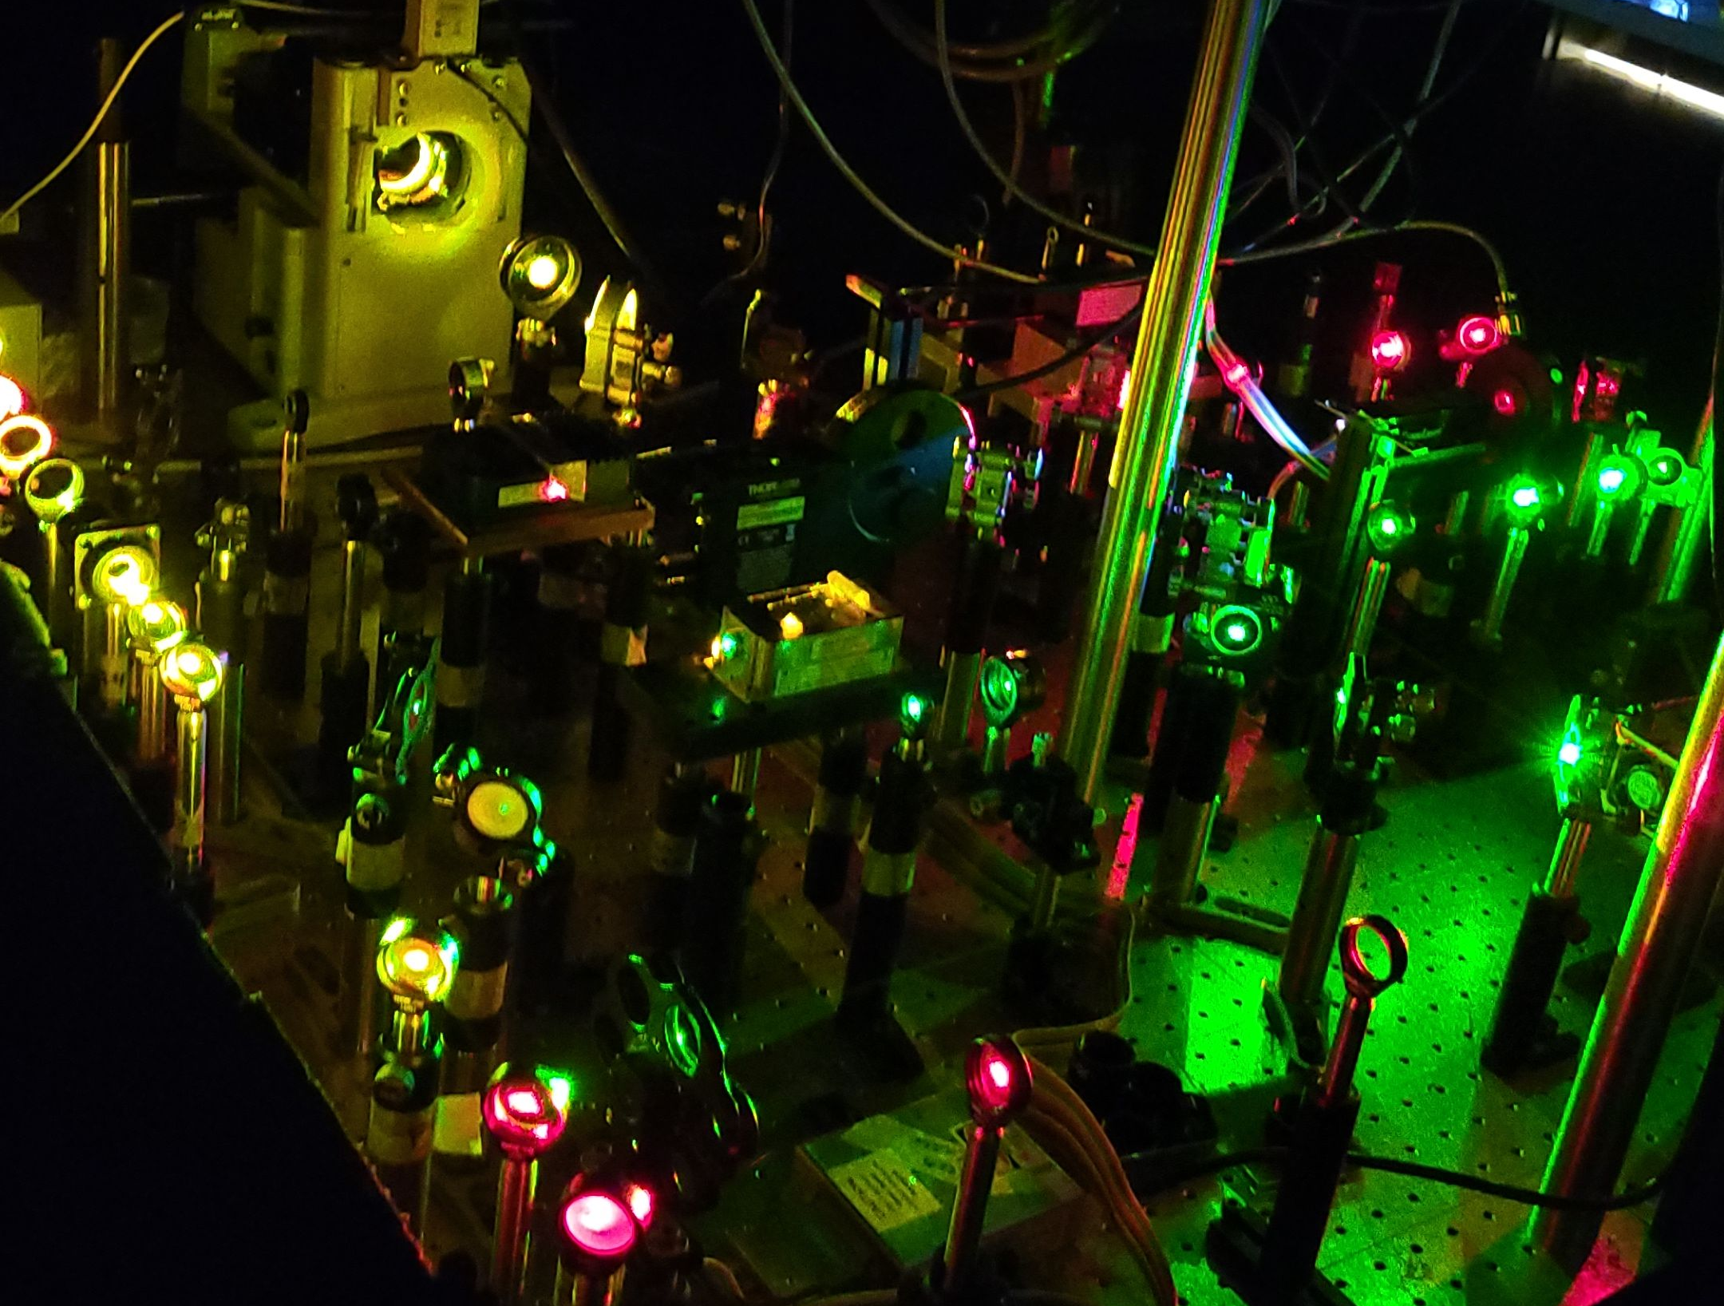
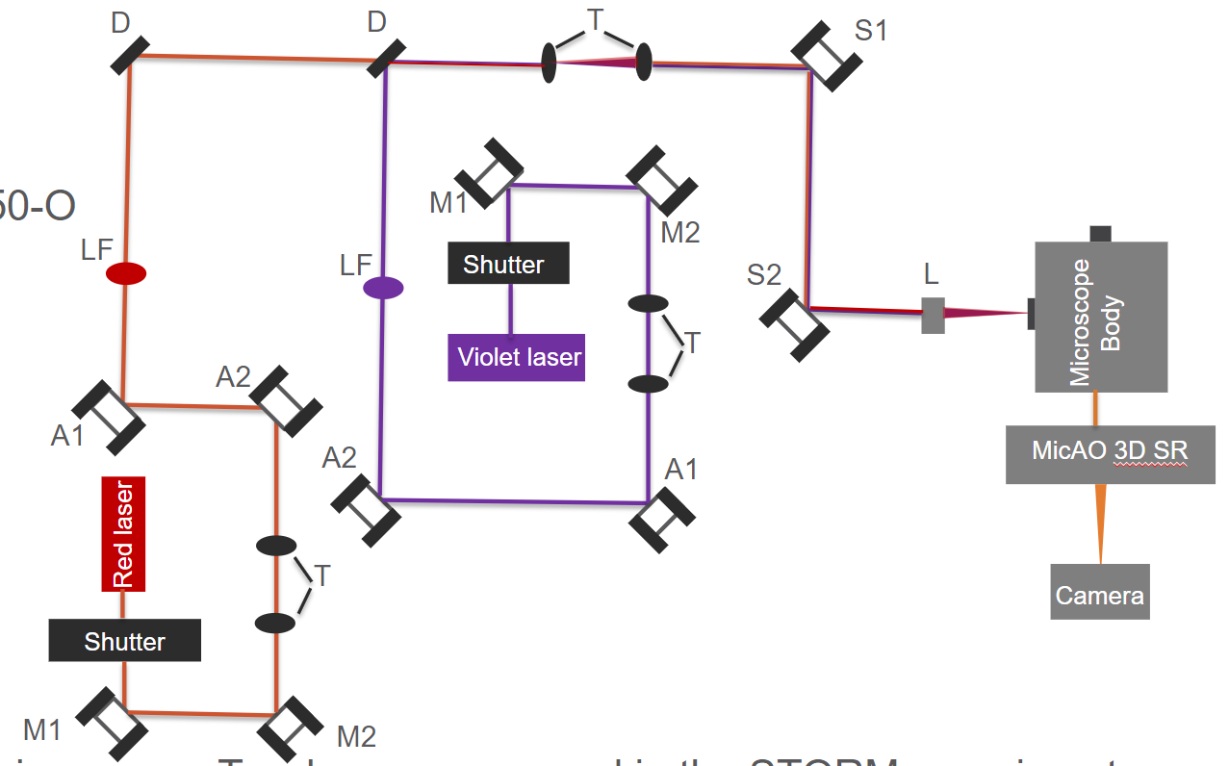
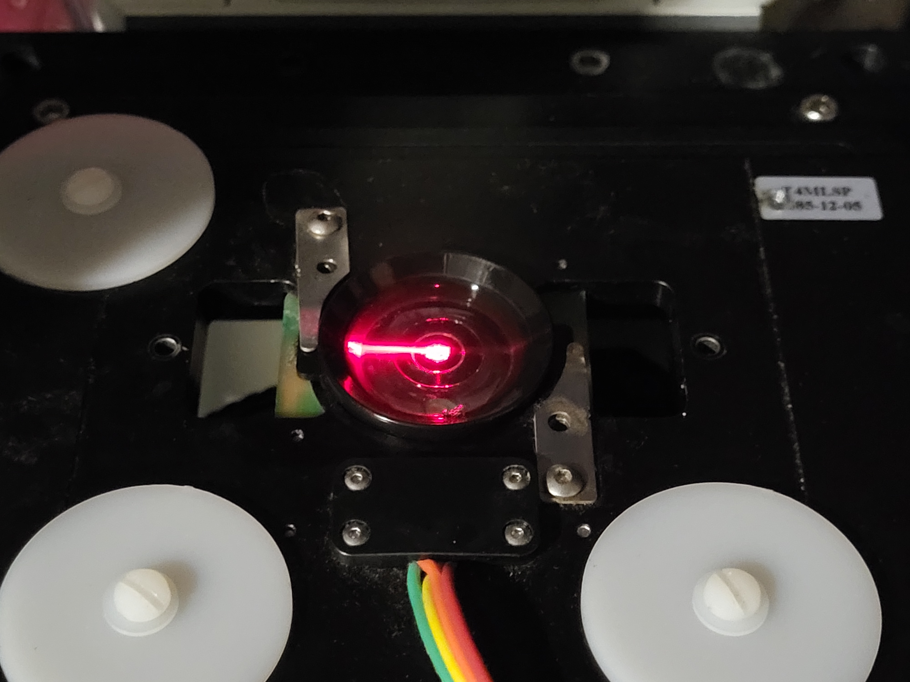
SPT: Imaging Setup (TIRF)
D1
D2
T2
S1
ND
FL
M4
M3
S2
T1
M1
M2
Adapted from Reshma Sunny, (2022)

Slide 15
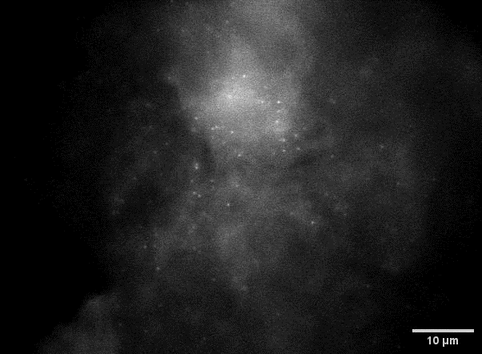
SPT: Imaging
Data from our TIRF microscope in Scott
10 fps
Tracking:
TrackMate plugin (ImageJ) for automated tracking of RNAs

Slide 16
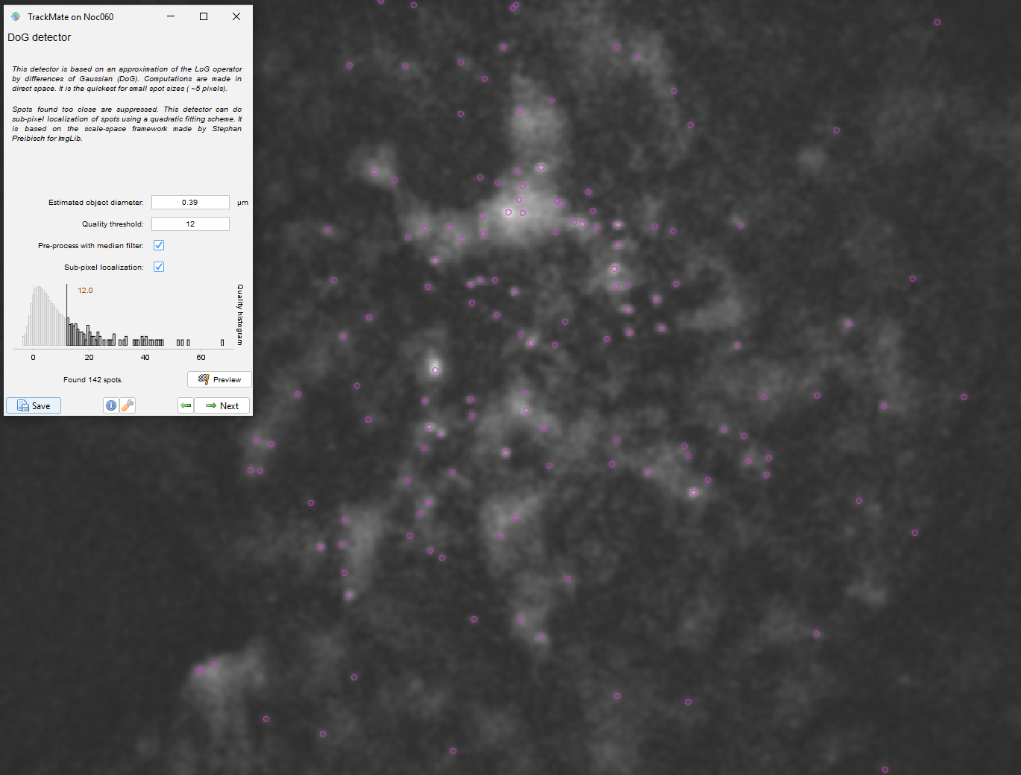

Tracking
TrackMate (ImageJ)
Background subtraction
Gaussian blur
Particle diameter
~0.39 µm
1 px = 0.13 µm
Intensity threshold

Slide 17
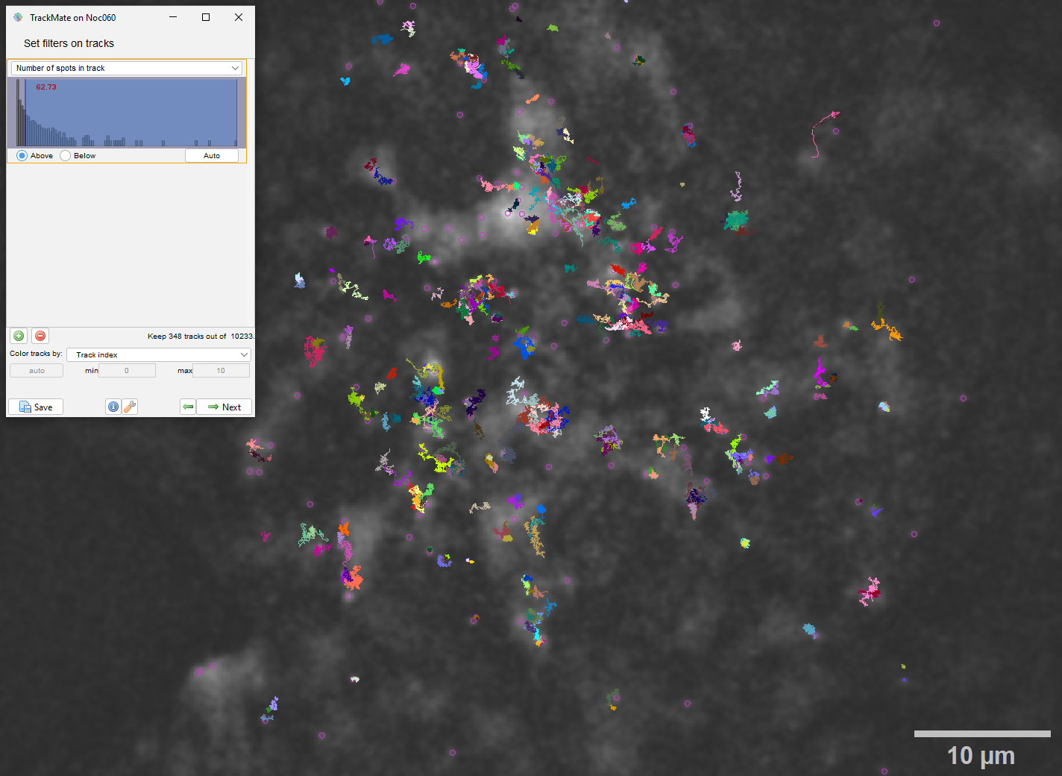
Tracking
TrackMate (ImageJ)
Linking max distance
Gap-closing max frame gap
Gap-closing max distance
Trajectories filtered for > 62 frames in length, colored by ID

Slide 18
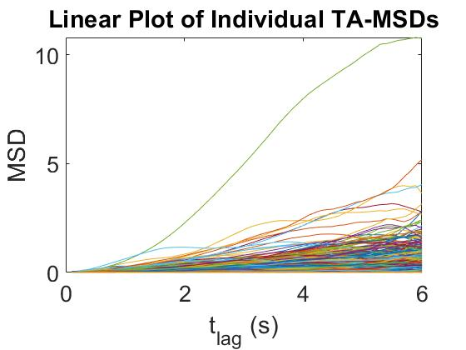
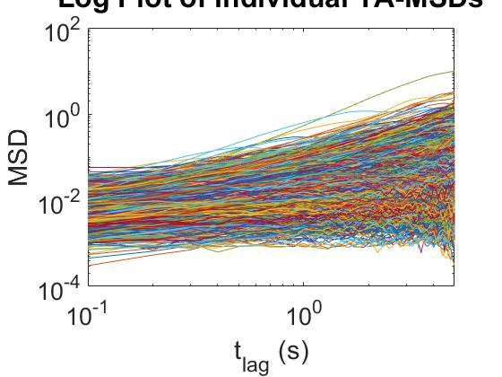
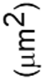
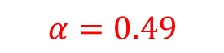
Analysis
Individual TA-MSDs (5,820 trajectories)
Individual TA-MSDs (5,820 trajectories)
$$α=0.49$$
Anomalous diffusion → Subdiffusive on average
Ergodicity breaking (D varies for each trajectory)

Slide 19
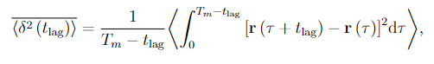
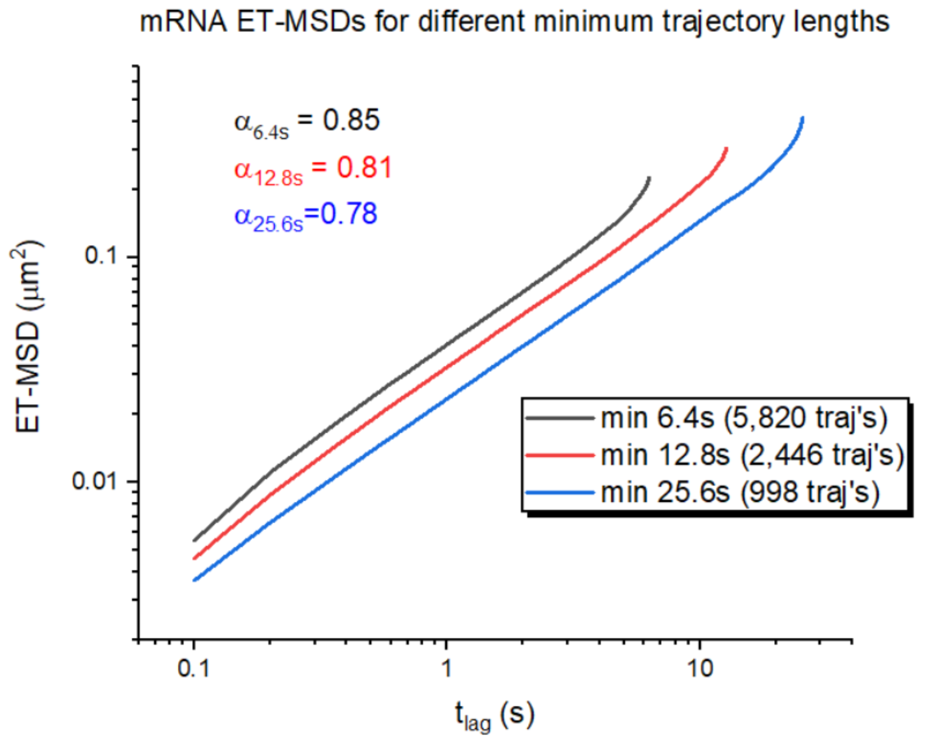
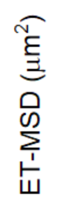
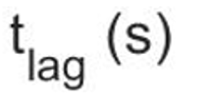
Analysis
ET-MSD:
mRNA ET-MSDs
Subdiffusive
Maybe a bias for confined trajectories to be longer because TrackMate doesn’t lose them as fast

Slide 20
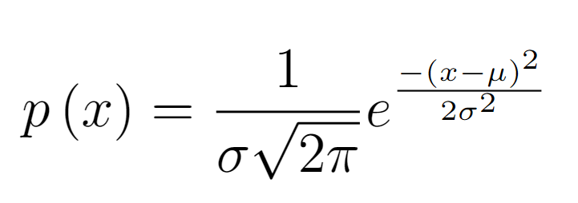
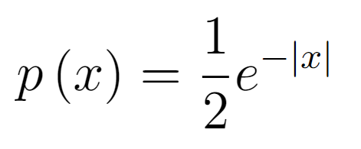
Distribution of Displacements
Gaussian:
Laplace:
Laplace distribution: heterogeneity across trajectories

Slide 21
Distribution of Displacements
Some heterogeneity within trajectories

Slide 22
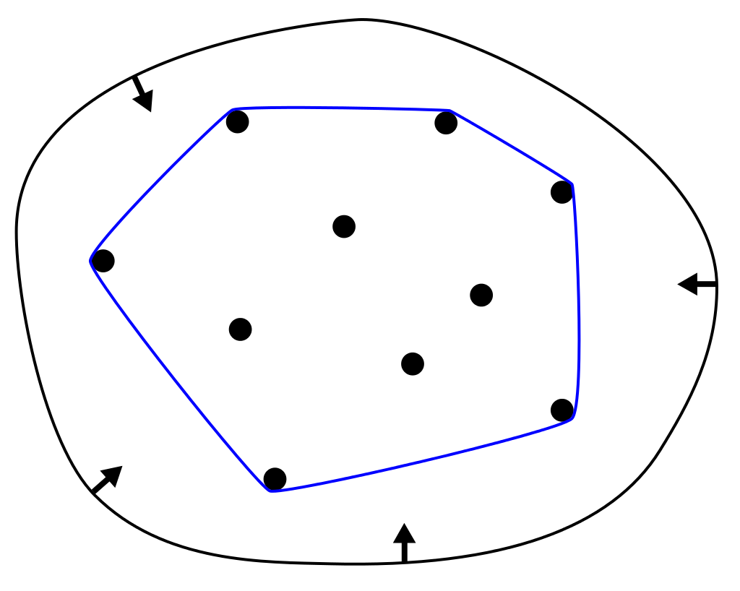

Segmentation
Convex Hull
16
End
6
6
5
13
13
4
13
Start
3
4
Parameters:
Window size (frames)
Threshold for two states
~ 0.5 µm
Lanoiselee and Grebenkov, PRE 2017

Slide 23




Segmentation
“Free” > Th
“Confined” < Th
Th = 0.42
1 µm

Slide 24

Segmentation
Free state ET-MSD ~1 order of magnitude higher than confined state
Quantitative confirmation of segmentation

Slide 25
Distribution of Displacements by State
Free Confined
Gaussian
Gaussian
Free state: Deviation from Gaussian: more heterogeneous

Slide 26


Sojourn Times
Free Confined
$$p\left(t\right) \sim e^{−λt}$$
$$p\left(t\right) \sim t^{−α}$$
Survival Probability
Survival Probability
Time (s)
Time (s)
Free state: Exponential distribution Confined state: Power-law distribution
(times between jumps/states can be very long)

Slide 27



Removal of First Confined Segment
Free state exhibits an exponential distribution of waiting times (no memory/correlations)
Probability of each waiting time is independent of previous ones
Thus, we want trajectories to start in a free state
Original Removed Overlayed

Slide 28




Analysis
ET-MSD: $\left\langle \overline{δ^{2}(t_{lag})}\right\rangle = \frac{1}{T_{m}−t_{lag}}\int_{0}^{T_{m}−t_{lag}}{{\left[r\left(τ+t_{lag}\right)−r\left(τ\right)\right]}^{2}dτ}$
Confocal data
4 focal planes (0.5 µm depth)
~ 2 µm depth & 1.5 fps
Maximum intensity projection
Exhibits aging
$\left\langle \overline{δ^{2}(τ,T_{m})}\right\rangle ∼\frac{τ^{β}}{T_{m}^{1−α}}$ $∼\frac{τ^{0.55}}{T_{m}^{0.44}}$ → $α$ = 0.56 | $β$ = 0.55
248 trajectories
103 trajectories

Slide 29

Analysis
PSD: $S_{T}\left(ω\right)=\left\langle \frac{1}{T}{\left|\int_{0}^{T}{e^{iωt}X\left(t\right)dt}\right|}^{2}\right\rangle$
Confocal data
4 focal planes (0.5 µm depth)
~ 2 µm depth & 1.5 fps
Maximum intensity projection
Exhibits aging
$\left\langle S\left(ω,T_{m}\right)\right\rangle ∼\frac{1}{T_{m}^{1−α}ω^{1+β}}$ $∼\frac{1}{T_{m}^{0.47}ω^{1.45}}$ → $α$ = 0.53 | $β$ = 0.45
248 trajectories
103 trajectories

Slide 30



Analysis
mRNA PSD vs. Observation Time
Minimum Trajectory Length of 6.4 s
mRNA PSD vs. Observation Time
Minimum Trajectory Length of 12.8 s
mRNA PSD vs. Observation Time
Minimum Trajectory Length of 25.6 s
5,820 trajectories
2,446 trajectories
998 trajectories
TIRF data
All minimum length trajectories exhibit aging PSDs

Slide 31

Long Free States (> 27 s)
78% of these RNAs are found near cell periphery

Slide 32
Conclusions
mRNA is subdiffusive and non-ergodic with stochastic switching between “free” and “confined” mobility states, and exhibits aging
Mobility states differ by an order of magnitude in MSD
Free state is more transient, whereas the confined state has power-law waiting times
Molecules that experience “long” free states tend to be near the cell periphery
Hypothesis: confined states represent translation
1 µm

Slide 33

Future / Ongoing Work
Disruption of translation & intracellular structures
See how miRNA interacts with mRNA
How does the introduction of miRNA change transcription and translation?

Slide 34


Acknowledgements
Diego Krapf
O’Neil Wiggan
Carsten Dietvorst
Snehal Patil
Tim Stasevich

